Slide 1
Cooperative Learning: An Evidence-Based Practice for Innovative Education
Karl A. Smith
Engineering Education – Purdue University
STEM Education Center/Civil Eng – University of Minnesota
ksmith@umn.edu - http://www.ce.umn.edu/~smith/
Teaching and Learning Center
King Fahd University of Petroleum and Minerals
26 August 2012

Slide 2
Overview
Seminar
  Welcome & Overview
  Cooperative Learning Basics & Rationale
  Course Design Foundations
Workshop Preview – Formal Cooperative Learning – Design, Implementation and Assessment
  Informal Cooperative Learning (Brief Summary)
    Book Ends on a Class Session
  Formal Cooperative Learning
    Problem-Based Cooperative Learning

Slide 3
Participant Learning Goals (Objectives)
  Describe key features of Cooperative Learning
  Describe key features of the Understanding by Design and How People Learn
  Explain rationale for Pedagogies of Engagement, especially Cooperative Learning & Challenge Based Learning
  Apply cooperative learning to classroom practice
  Identify connections between cooperative learning and desired outcomes of courses and programs

Slide 4
Cooperative Learning and Engineering Education Karl Smith
Research
Process Metallurgy 1970 -1992
Learning ~1974
Design ~1995
Engineering Education Research & Innovation ~ 2000
STEM Education ~ 2010
Innovation – Cooperative Learning
Need identified ~1974
Introduced ~1976
FIE conference 1981
JEE paper 1981
Research book 1991
Practice handbook 1991
Change paper 1998
Teamwork and project management 2000
JEE paper 2005
National Academy of Engineering - Frontiers of Engineering Education Symposium - December 13-16, 2010 - Slides PDF [Smith-NAE-FOEE-HPL-UbD-12-10-v8.pdf]
Notes:
In this seminar I plan to provide links between my experience as a researcher and an innovation that I’m associated with. I’m using Denning and Dunhams (2010) definition of innovation as the adoption of a new practice in a community. Several researchers argue that a principal aspect of innovation is novel combinations, and I will highlight this aspect, too. Individual reflection – what link between research and innovation are you or would you like to be know for?

Slide 5
Process Metallurgy
Dissolution Kinetics – liquid-solid interface
Iron Ore Desliming – solid-solid interface
Metal-oxide reduction roasting – gas-solid interface
Notes:
My process metallurgy experience was at interfaces, which I think helped position me for work at the engineering and education interface

Slide 6
Dissolution Kinetics
Theory – Governing Equation for Mass Transport
Research – rotating disk
Practice – leaching of silver bearing metallic copper

Slide 7
First Teaching Experience
Practice – Third-year course in metallurgical reactions – thermodynamics and kinetics

Slide 8
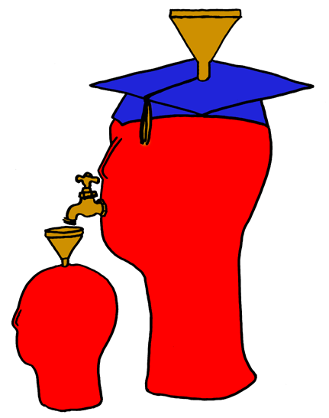
Lila M. Smith
Notes:
8:30-9:30?Take copies of Active Lrn, HTMI, New Paradigms,

Slide 9
Engineering Education
Practice – Third-year course in metallurgical reactions – thermodynamics and kinetics
Research – ?
Theory – ?
Theory
Research
Evidence
Practice

Slide 10
University of Minnesota College of Education
Social, Psychological and Philosophical Foundations of Education
Statistics, Measurement, Research Methodology
Assessment and Evaluation
Learning and Cognitive Psychology
Knowledge Acquisition, Artificial Intelligence, Expert Systems
Development Theories
Motivation Theories
Social psychology of learning – student – student interaction

Slide 11
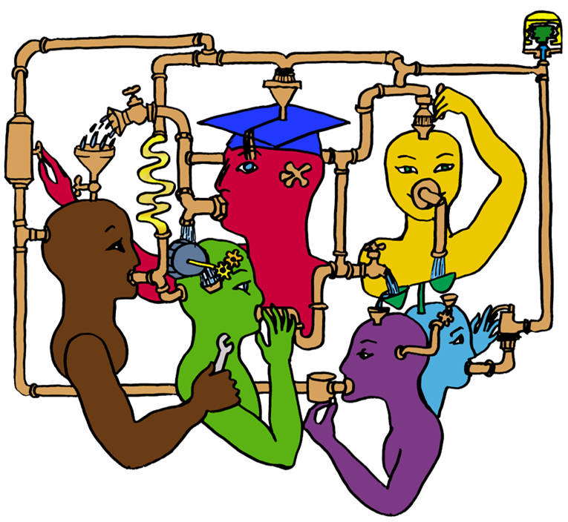
Lila M. Smith
Notes:
8:30-9:30?Take copies of Active Lrn, HTMI, New Paradigms,

Slide 12
Cooperative Learning
Theory – Social Interdependence – Lewin – Deutsch – Johnson & Johnson
Research – Randomized Design Field Experiments
Practice – Formal Teams/Professor’s Role
Theory
Research
Evidence
Practice

Slide 13

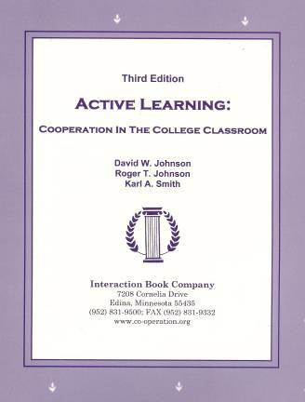
Cooperative Learning
•Positive Interdependence
•Individual and Group Accountability
•Face-to-Face Promotive Interaction
•Teamwork Skills
•Group Processing
[*First edition 1991]

Slide 14
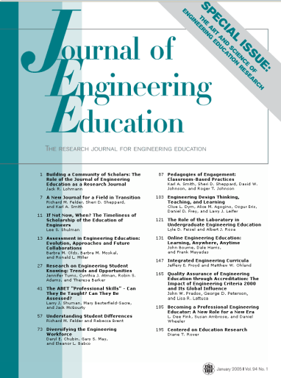

Cooperative Learning Research Support
Johnson, D.W., Johnson, R.T., & Smith, K.A. 1998. Cooperative learning returns to college: What evidence is there that it works? Change, 30 (4), 26-35.
• Over 300 Experimental Studies
• First study conducted in 1924
• High Generalizability
• Multiple Outcomes
Outcomes
1. Achievement and retention
2. Critical thinking and higher-level
reasoning
3. Differentiated views of others
4. Accurate understanding of others' perspectives
5. Liking for classmates and teacher
6. Liking for subject areas
7. Teamwork skills
January 2005
March 2007
Notes:
Table summarizes my perception of the shift. A version of this table is available in New Paradigms for Engineering Education -- FIE Conf proceedings 97 (avail on the www)
One of the most significant changes that has occurred is the shift from "pouring in knowledge" to "creating a climate where learning flows among students and the professor"

Slide 15
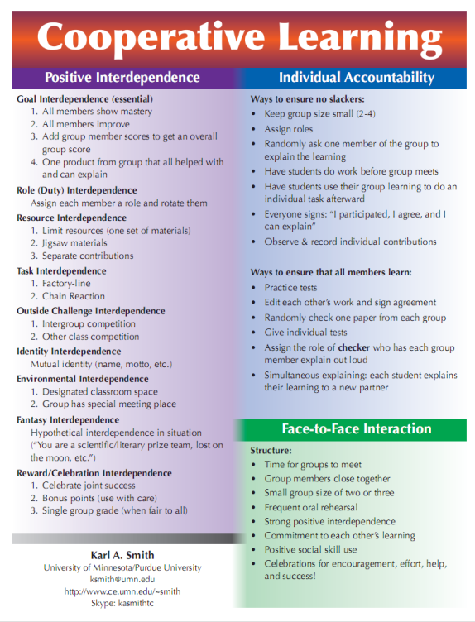
Cooperative Learning is instruction that involves people working in teams to accomplish a common goal, under conditions that involve both positive interdependence (all members must cooperate to complete the task) and individual and group accountability (each member is accountable for the complete final outcome).
Key Concepts
•Positive Interdependence
•Individual and Group Accountability
•Face-to-Face Promotive Interaction
•Teamwork Skills
•Group Processing
http://www.ce.umn.edu/~smith/docs/Smith-CL%20Handout%2008.pdf
Notes:
Table summarizes my perception of the shift. A version of this table is available in New Paradigms for Engineering Education -- FIE Conf proceedings 97 (avail on the www)
One of the most significant changes that has occurred is the shift from "pouring in knowledge" to "creating a climate where learning flows among students and the professor"

Slide 16
Seven Principles for Good Practice in Undergraduate Education
Good practice in undergraduate education:
  Encourages student-faculty contact
  Encourages cooperation among students
  Encourages active learning
  Gives prompt feedback
  Emphasizes time on task
  Communicates high expectations
  Respects diverse talents and ways of learning
Chickering & Gamson, June, 1987

Slide 17
Student Engagement Research Evidence
Perhaps the strongest conclusion that can be made is the least surprising. Simply put, the greater the student’s involvement or engagement in academic work or in the academic experience of college, the greater his or her level of knowledge acquisition and general cognitive development …(Pascarella and Terenzini, 2005).
Active and collaborative instruction coupled with various means to encourage student engagement invariably lead to better student learning outcomes irrespective of academic discipline (Kuh et al., 2005, 2007).
See Smith, et.al, 2005 and Fairweather, 2008, Linking Evidence and Promising Practices in Science, Technology, Engineering, and Mathematics (STEM) Undergraduate Education - http://www7.nationalacademies.org/bose/Fairweather_CommissionedPaper.pdf

Slide 18
Small-Group Learning: Meta-analysis
Springer, L., Stanne, M. E., & Donovan, S. 1999. Effects of small-group learning on undergraduates in science, mathematics, engineering, and technology: A meta-analysis. Review of Educational Research, 69(1), 21-52.
Small-group (predominantly cooperative) learning in postsecondary science, mathematics, engineering, and technology (SMET). 383 reports from 1980 or later, 39 of which met the rigorous inclusion criteria for meta-analysis.
The main effect of small-group learning on achievement, persistence, and attitudes among undergraduates in SMET was significant and positive. Mean effect sizes for achievement, persistence, and attitudes were 0.51, 0.46, and 0.55, respectively.
Notes:
Table summarizes my perception of the shift. A version of this table is available in New Paradigms for Engineering Education -- FIE Conf proceedings 97 (avail on the www)
One of the most significant changes that has occurred is the shift from "pouring in knowledge" to "creating a climate where learning flows among students and the professor"

Slide 19
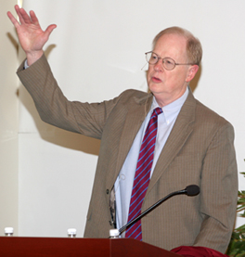
“It could well be that faculty members of the twenty-first century college or university will find it necessary to set aside their roles as teachers and instead become designers of learning experiences, processes, and environments.”
James Duderstadt, 1999
Nuclear Engineering Professor; Dean, Provost and President of the University of Michigan

Slide 20
What do you already know about course design?
[Background Knowledge Survey]
Short Answer Questions
What do you feel are important considerations about course (re) design?
What are challenges you have faced with course (re) design?

Slide 21
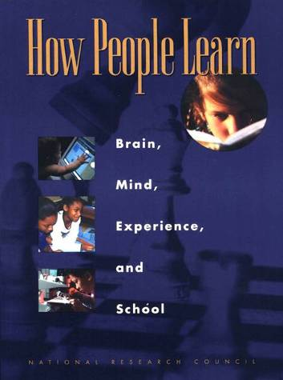
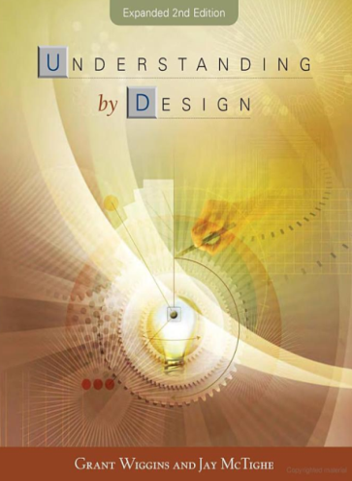
Design Foundations
Science of Instruction (UbD)
 | No | Yes
Yes | Good Theory/ Poor Practice | Good Theory & Good Practice
No |  | Good Practice/ Poor Theory
Science of Learning
(HPL)
Sources: Bransford, Brown & Cocking. 1999. How people learn. National Academy Press.
Wiggins, G. & McTighe, J. 2005. Understanding by design, 2ed. ASCD.
Notes:
Models of how learning works – (1) learning as response strengthening, (2) learning as information acquisition, (3) learning as knowledge construction and (4) learning as social knowledge construction

Slide 22
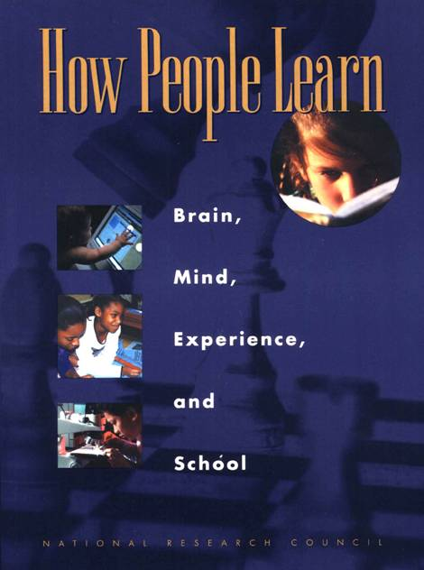
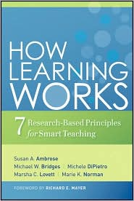
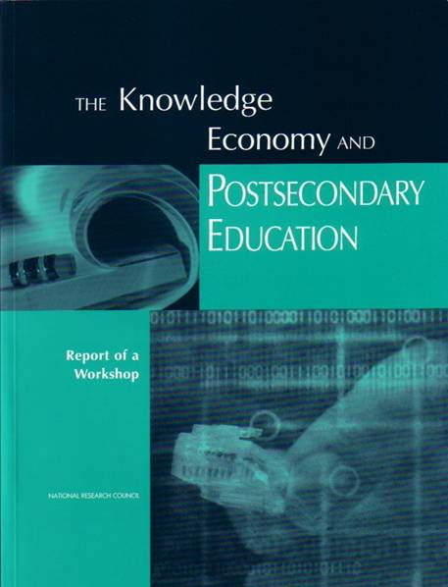
Bransford, Vye and Bateman – Creating High Quality Learning Environments

Slide 23
Students prior knowledge can help or hinder learning
How student organize knowledge influences how they learn and apply what they know
Students’ motivation determines, directs, and sustains what they do to learn
To develop mastery, students must acquire component skills, practice integrating them, and know when to apply what they have learned
Goal-directed practice coupled with targeted feedback enhances the quality of students’ learning
Students’ current level of development interacts with the social, emotional, and intellectual climate of the course to impact learning
To become self-directed learners, students must learn to monitor and adjust their approach to learning

Slide 24
Understanding by Design
Wiggins & McTighe (1997, 2005)
Stage 1. Identify Desired Results
Enduring understanding
Important to know and do
Worth being familiar with
Stage 2. Determine Acceptable Evidence
Stage 3. Plan Learning Experiences
and Instruction
Overall: Are the desired results, assessments, and learning activities ALIGNED?
From: Wiggins, Grant and McTighe, Jay. 1997. Understanding by Design. Alexandria, VA: ASCD
24
Notes:
24

Slide 25
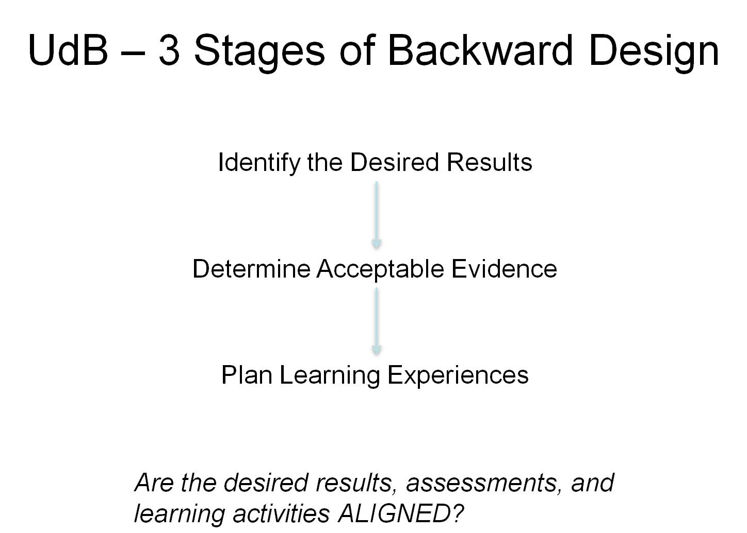
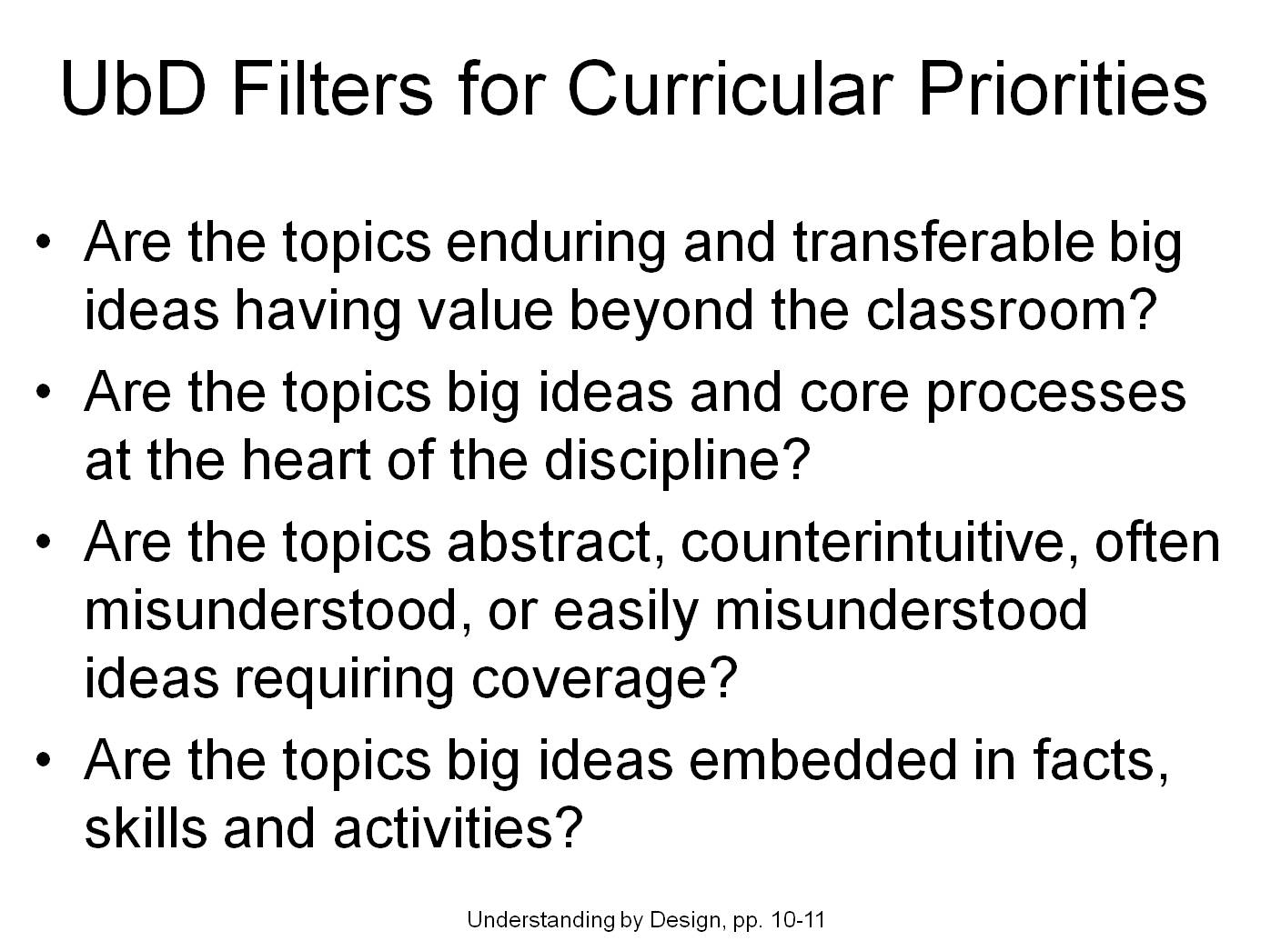
Content-Assessment-Pedagogy (CAP) Design Process Flowchart
Understanding by Design (Wiggins & McTighe, 2005)
Start
Context
Backward Design
Content
Assessment
Pedagogy
No
C & A & P
Alignment?
Yes
End
Streveler, Smith & Pilotte (2011)
Notes:
25

Slide 26
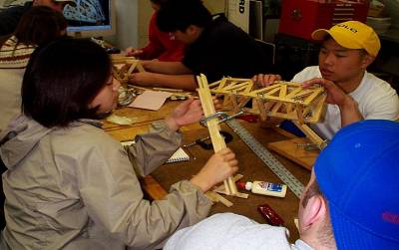
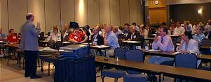
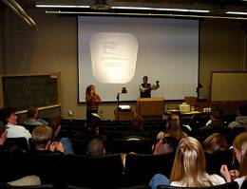
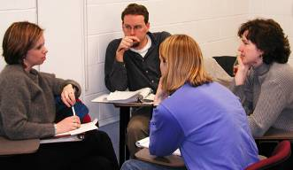
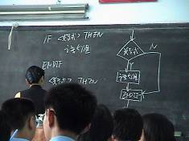
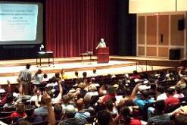
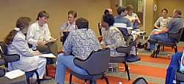
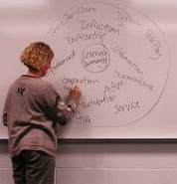
Pedagogies of Engagement

Slide 27
The Active Learning Continuum
Informal
Group
Activities
Structured
Team
Activities
Problems
Drive the
Course
Make the
lecture active
Instructor
Centered
Student
Centered
Active
Learning
Collaborative
Learning
Cooperative
Learning
Problem-
Based
Learning
Prince, M. (2010). NAE FOEE
My work is situated here – Cooperative
Learning & Challenge-Based Learning

Slide 28
Active Learning: Cooperation in the College Classroom
Informal Cooperative Learning Groups
Formal Cooperative Learning Groups
Cooperative Base Groups
See Cooperative Learning
Handout (CL College-804.doc)

Slide 29
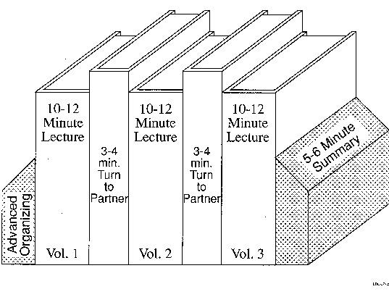
Book Ends on a Class Session
Smith, K.A. 2000. Going deeper: Formal small-group learning in large classes. Energizing large classes: From small groups to learning communities. New Directions for Teaching and Learning, 2000, 81, 25-46. [NDTL81Ch3GoingDeeper.pdf]

Slide 30
Informal CL (Book Ends on a Class Session) with Concept Tests
Physics
Peer Instruction
Eric Mazur - Harvard – http://galileo.harvard.edu
Peer Instruction – www.prenhall.com
Richard Hake – http://www.physics.indiana.edu/~hake/
Chemistry
Chemistry ConcepTests - UW Madison www.chem.wisc.edu/~concept
Video: Making Lectures Interactive with ConcepTests
ModularChem Consortium – http://mc2.cchem.berkeley.edu/
STEMTEC
Video: How Change Happens: Breaking the “Teach as You Were Taught” Cycle – Films for the Humanities & Sciences – www.films.com
Harvard – Derek Bok Center
Thinking Together & From Questions to Concepts: Interactive Teaching in Physics – www.fas.harvard.edu/~bok_cen/

Slide 31
The “Hake” Plot of FCI
35.00
SDI
30.00
UMn-CL+PS
ALS
X
WP
25.00
UMn Cooperative Groups
X
20.00
PI(HU)
15.00
UMn Traditional
ASU(nc)
10.00
WP*
ASU(c)
HU
5.00
0.00
20.00
30.00
40.00
50.00
60.00
70.00
80.00
Pretest (Percent)

Slide 32
Richard Hake (Interactive engagement vs traditional methods) http://www.physics.indiana.edu/~hake/
Traditional (lecture)
Interactive (active/cooperative)
<g> = Concept Inventory Gain/Total
Notes:
Barr & Tagg's From teaching to learing is the most often requested article from Change mangazine
Bill Camplbell and I started working on New Paradigms in 1993.

Slide 34
Cooperative Learning Adopted
The American College Teacher:
National Norms for 2007-2008
Methods Used in “All” or “Most” | All – 2005 | All – 2008 | Assistant - 2008
Cooperative Learning | 48 | 59 | 66
Group Projects | 33 | 36 | 61
Grading on a curve | 19 | 17 | 14
Term/research papers | 35 | 44 | 47
http://www.heri.ucla.edu/index.php

Slide 35

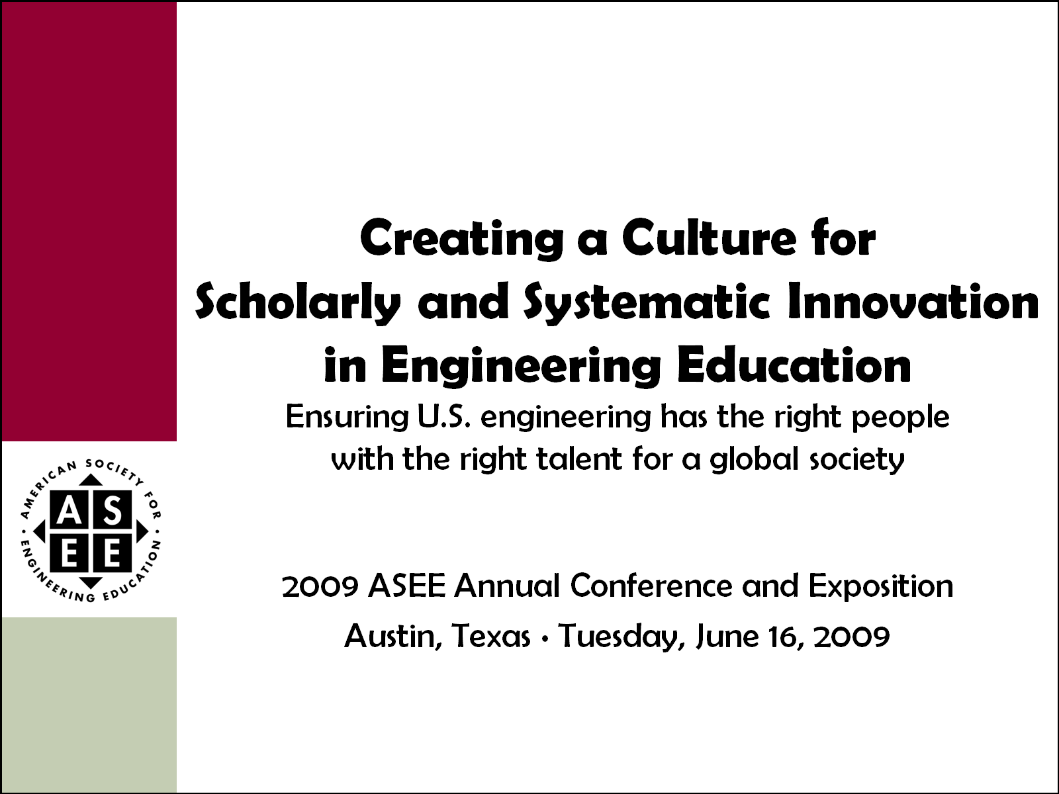
Celebration of Two Major
ASEE Milestones
2011 ASEE Annual Conference and Exposition
Vancouver, British Columbia ∙ Monday, June 27, 2011

Slide 36
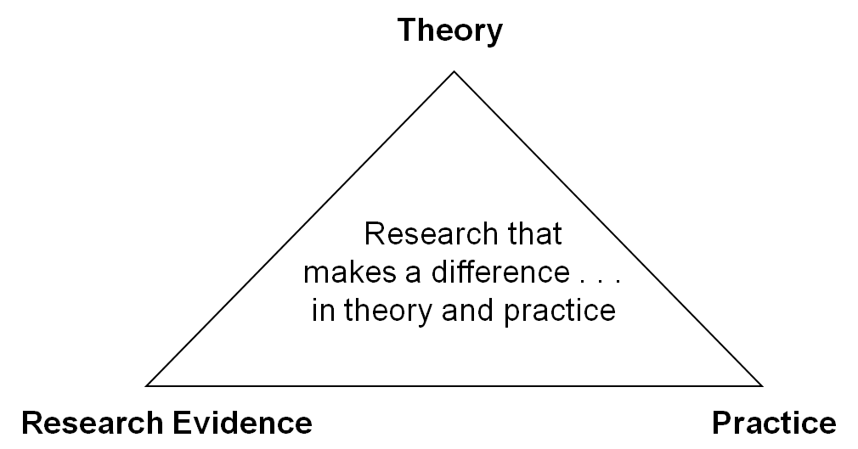
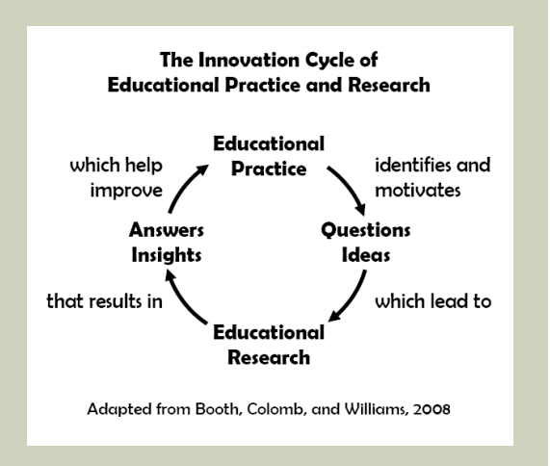

One BIG Idea; Two Perspectives
Jamieson & Lohmann (2009)
Engineering Education Innovation

Slide 37

ASEE Main Plenary, 8:45 a.m. – 10:15 a.m.
Vancouver International Conference Centre, West Ballroom CD
Expected to draw over 2,000 attendees, this year’s plenary features Karl A. Smith, Cooperative Learning Professor of Engineering Education at Purdue University and Morse–Alumni Distinguished Teaching Professor & Professor of Civil Engineering at the University of Minnesota.
Smith has been at the University of Minnesota since 1972 and has been active in ASEE since he became a member in 1973. For the past five years, he has been helping start the engineering education Ph.D. program at Purdue University. He is a Fellow of the American Society for Engineering Education and past Chair of the Educational Research and Methods Division. He has worked with thousands of faculty all over the world on pedagogies of engagement, especially cooperative learning, problem-based learning, and constructive controversy.
On the occasion of the 100th anniversary of the Journal of Engineering Education and the release of ASEE’s Phase II report Creating a Culture for Scholarly and Systematic Innovation in Engineering Education (Jamieson/Lohmann report), the plenary will celebrate these milestones and demonstrate rich, mutual interdependences between practice and inquiry into teaching and learning in engineering education. Depth and range of the plenary will energize the audience and reflects expertise and interests of conference participants. One of ASEE’s premier educators and researchers, Smith will draw upon our roots in scholarship to set the stage and weave the transitions for six highlighted topics selected for their broad appeal across established, evolving, and emerging practices in engineering education.
Video: https://secure.vimeo.com/27147996
Slides: http://www.ce.umn.edu/~smith/links.html
http://www.asee.org/conferences-and-events/conferences/annual-conference/2011/program-schedule/conference-highlights

Slide 38
Active Learning: Cooperation in the College Classroom
Informal Cooperative Learning Groups
Formal Cooperative Learning Groups
Cooperative Base Groups
See Cooperative Learning
Handout (CL College-804.doc)

Slide 39
Professor's Role in
Formal Cooperative Learning
Specifying Objectives
Making Decisions
Explaining Task, Positive Interdependence, and Individual Accountability
Monitoring and Intervening to Teach Skills
Evaluating Students' Achievement and Group Effectiveness

Slide 40
Formal Cooperative Learning – Types of Tasks
Jigsaw – Learning new conceptual/procedural material
2. Peer Composition or Editing
3. Reading Comprehension/Interpretation
4. Problem Solving, Project, or Presentation
5. Review/Correct Homework
6. Constructive Academic Controversy
7. Group Tests
Notes:
Table summarizes my perception of the shift. A version of this table is available in New Paradigms for Engineering Education -- FIE Conf proceedings 97 (avail on the www)
One of the most significant changes that has occurred is the shift from "pouring in knowledge" to "creating a climate where learning flows among students and the professor"

Slide 41
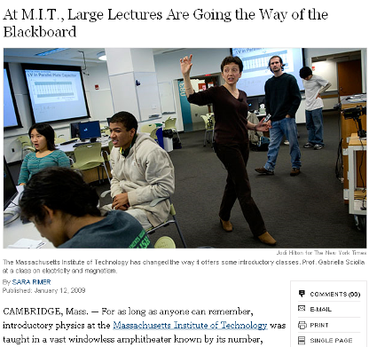
Problem-Based Cooperative Learning
January 13, 2009—New York Times – http://www.nytimes.com/2009/01/13/us/13physics.html?em

Slide 42
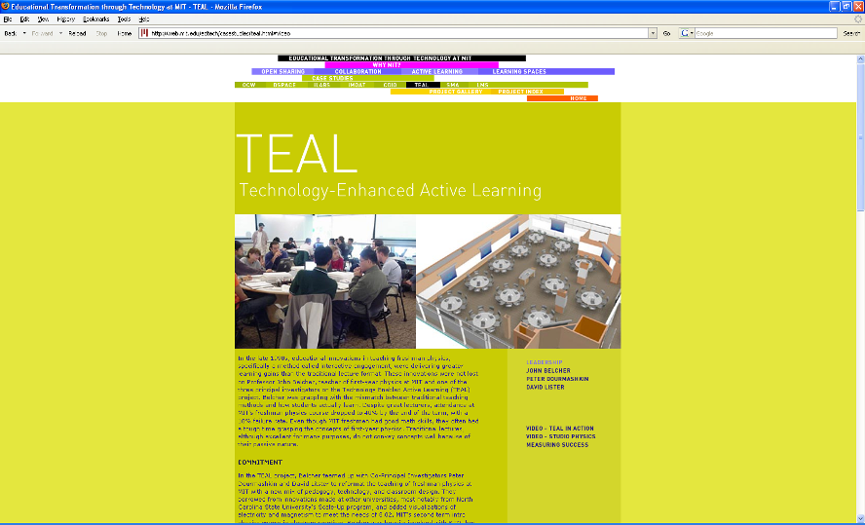
http://web.mit.edu/edtech/casestudies/teal.html#video

Slide 43
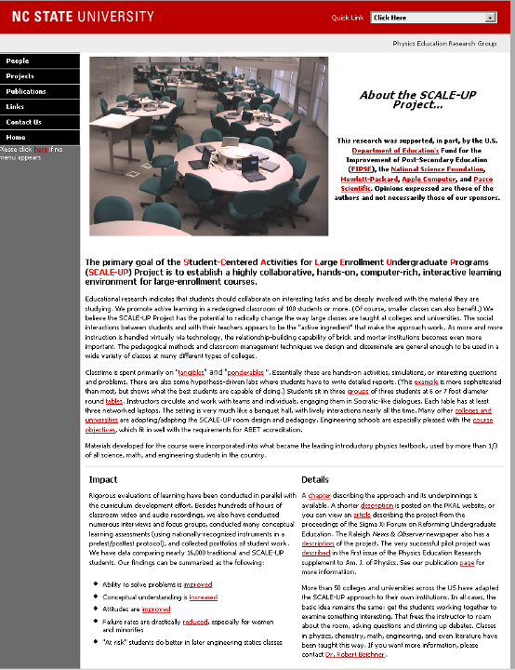
http://www.ncsu.edu/PER/scaleup.html

Slide 44


http://mediamill.cla.umn.edu/mediamill/embed/78755
http://www1.umn.edu/news/news-releases/2010/UR_CONTENT_248261.html
http://www.youtube.com/watch?v=lfT_hoiuY8w
http://youtu.be/lfT_hoiuY8w

Slide 45
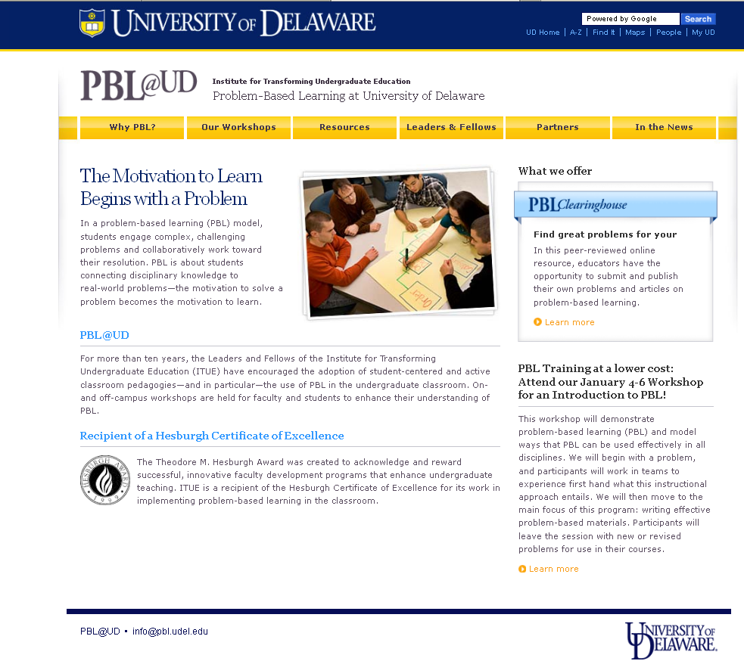
http://www.udel.edu/inst/

Slide 46
Afternoon Session Preview
Design and Implementation of Active and Cooperative Learning
  Pedagogies of Engagement – Cooperative Learning and Challenge Based Learning
  Formal Cooperative Learning
    Instructor’s Role
Preparation for Afternoon Session
  Reflect on your use of student teams
    List things that are working well
    List problems you’ve encountered

Slide 47
Resources
Design Framework – How People Learn (HPL) & Understanding by Design (UdB) Process
  Bransford, John, Vye, Nancy, and Bateman, Helen. 2002. Creating High-Quality Learning Environments: Guidelines from Research on How People Learn. The Knowledge Economy and Postsecondary Education: Report of a Workshop. National Research Council. Committee on the Impact of the Changing Economy of the Education System. P.A. Graham and N.G. Stacey (Eds.). Center for Education. Washington, DC: National Academy Press. http://www.nap.edu/openbook/0309082927/html/
  Mayer, R. E. 2010. Applying the science of learning. Upper Saddle River, NJ: Pearson.
  Pellegrino – Rethinking and redesigning curriculum, instruction and assessment: What contemporary research and theory suggests. http://www.skillscommission.org/commissioned.htm
  Smith, K. A., Douglas, T. C., & Cox, M. 2009. Supportive teaching and learning strategies in STEM education. In R. Baldwin, (Ed.). Improving the climate for undergraduate teaching in STEM fields. New Directions for Teaching and Learning, 117, 19-32. San Francisco: Jossey-Bass.
  Wiggins, G. & McTighe, J. 2005. Understanding by Design: Expanded Second Edition. Prentice Hall.
Content Resources
  Donald, Janet. 2002. Learning to think: Disciplinary perspectives. San Francisco: Jossey-Bass.
  Middendorf, Joan and Pace, David. 2004. Decoding the Disciplines: A Model for Helping Students Learn Disciplinary Ways of Thinking. New Directions for Teaching and Learning, 98.
Cooperative Learning
  Cooperative Learning (Johnson, Johnson & Smith) - Smith web site – www.ce.umn.edu/~smith
  Smith (2010) Social nature of learning: From small groups to learning communities. New Directions for Teaching and Learning, 2010, 123, 11-22 [NDTL-123-2-Smith-Social_Basis_of_Learning-.pdf]
  Smith, Sheppard, Johnson & Johnson (2005) Pedagogies of Engagement [Smith-Pedagogies_of_Engagement.pdf]
  Johnson, Johnson & Smith. 1998. Cooperative learning returns to college: What evidence is there that it works? Change, 1998, 30 (4), 26-35. [CLReturnstoCollege.pdf]
Other Resources
  University of Delaware PBL web site – www.udel.edu/pbl
  PKAL – Pedagogies of Engagement – http://www.pkal.org/activities/PedagogiesOfEngagementSummit.cfm
  Fairweather (2008) Linking Evidence and Promising Practices in Science, Technology, Engineering, and Mathematics (STEM) Undergraduate Education - http://www7.nationalacademies.org/bose/Fairweather_CommissionedPaper.pdf

Slide 48

Thank you!
An e-copy of this presentation is posted to:
http://www.ce.umn.edu/~smith/links.html
King Fahd University of Petroleum and Minerals – 26 August 2012
ksmith@umn.edu

